Slide 1
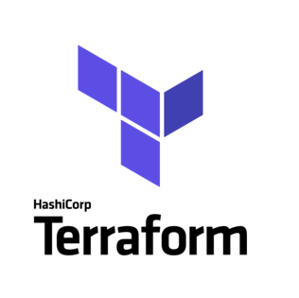
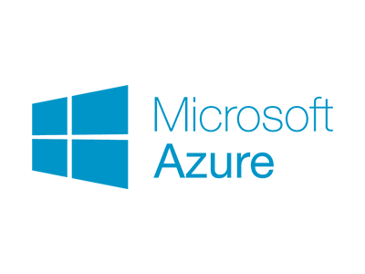
Terraform in Microsoft Azure
A quick Start
Notes:
Infrastructure as Code (IaC) is becoming very popular as it enables you to describe a comprehensive blueprint of a data center using complex configuration syntax,
This can be versioned and script-automated.
It brings huge enhancement in the efficiency and reliability of provisioning and reserved environments.

Slide 2


What is Terraform?
Terraform is a tool to Build, Change, and Version Control infrastructure.
Notes:
Automation: Automate all the things
Version Control
Continuous Integration and Deployment
Prerequisites:
An Azure account.
A system with Terraform 0.12.6 or later installed

Slide 3








Infrastructure as code
Define
Provision
Configure
Create a declarative set of files that define what your desired environment should look like. Include things like variables and modules to make your templates flexible.
Leverage modern tools to read your definition files, interrogate your existing environment, and provision the desired resources.
Interface with existing environments and applications to apply configuration settings specified in the definition files.
Target any cloud, on-premises data centers, and more
Notes:
Managing, provisioning, and configuring your application environment by defining what it should look like, in code.
Infrastructure is really a misnomer – environment and configuration as code
Any environment, any cloud, or even a datacenter

Slide 4

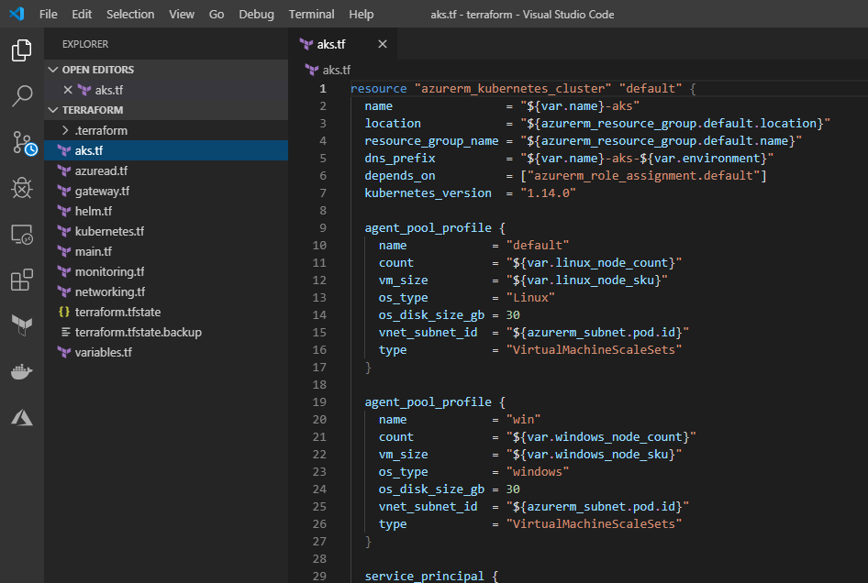

Why infrastructure as code?
Stand up environments in the fastest means possible.
Remove the human element and reliably and repeatable deploy every time.
Improve environment visibility and improve developer efficiency
Store your infrastructure definitions alongside your application code.
Notes:
Increase speed
Reduce risk
Reduce cost
Leverage developer best practices

Slide 5
Why Terraform?
Fast
Less errors
Using templates
Reduces cost
Notes:
Setting up infrastructure requires long time to have everything deployed and tested, with terraform this can be done in much less time and effort
It lowers the probable human errors while deploying and managing infrastructure.
It helps in deploying the same template multiple times to build identical development, test, and production environments.
Reduces the overall cost of development and test environments by creating them on-demand.
Other advantage of using Terraform on Azure:
Change infrastructure
Apply incremental changes
Destroy when needed
Preview changes
Scale easily

Slide 6
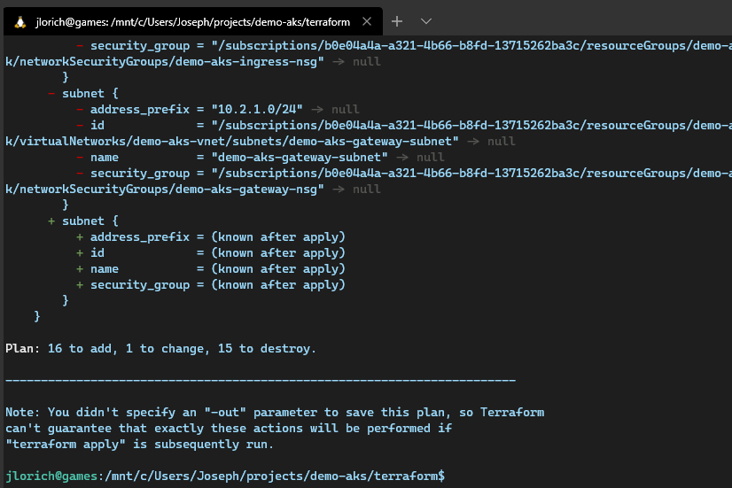
Terraform by HashiCorp
Use Infrastructure as Code to provision and manage any cloud, infrastructure, or service
Write declarative configuration files
Define infrastructure as code to manage the full lifecycle — create new resources, manage existing ones, and destroy those no longer needed.
Plan and predict changes
Terraform provides an elegant user experience for operators to safely and predictably make changes to infrastructure.
Create reproducible infrastructure
Terraform makes it easy to re-use configurations for similar infrastructure, helping you avoid mistakes and save time.
Notes:
Take everything we need to build out application and release our application and automate it

Slide 7
How to use Terraform
Directly from Azure Cloud Shell (Installed by default)
Installed on the target system
1. Donload the appropriate Terraform distribution package: https://www.terraform.io/downloads.html
2. Run terraform
3. Done!
Notes:
Optionally you can Modify the path (environment vaiable) to include the directory that contains the Terraform binary, this will allow you to run terraform on a system level.
To verify the installation execute: terraform (If you get an error that terraform could not be found, your PATH environment variable was not set up properly)

Slide 8
Steps to build infrastructure:
Initialize
Initialize the configuration directory
Usage: terraform init [options] [DIR]
Create
Create an execution plan
Usage: terraform plan [options] [dir]
Create or modify
Create or modify infrastructure
Usage: terraform apply [options] [dir-or-plan]
Notes:
(DEMO)
Terraform can configure resources across multiple clouds. For example, a single configuration can span both Azure and also other cloud providers. In such cases, there needs to be a way for Terraform to know how to manage each cloud.
There are three steps to build infrastructure with Terraform:
terraform init: performs several different initialization steps in order to prepare a working directory for use.
terraform plan: used to create an execution plan. Terraform performs a refresh, unless explicitly disabled, and then determines what actions are necessary to achieve the desired state specified in the configuration files. (use plan to see what you are about to deploy)
terraform apply used to apply the changes required to reach the desired state of the configuration, or the pre-determined set of actions generated by a terraform plan execution plan. (use apply to apply the changes )

Slide 9
Setting up the configuration files
AzureRM lets you create, modify, and delete Azure resources in a Terraform configuration.
Notes:
Terraform uses a declarative model for defining infrastructure: You write a configuration that declares your desired state and then leave it up to Terraform and the Azure provider to determine how to create and configure Azure to match the desired state.
Configuration files are made up of resources with settings and values representing the desired state of your infrastructure.
If you apply the configration file with no changes, terraform will not reaply although there is an advanced methoud to do that
»Configuration file format
HCL or JSON. ➔ .tf or .tf.json
Terraform to compare the configuration files with previous and current state of Azure resources. When you change a configuration and apply it to existing infrastructure, Terraform compares the new configuration to the state saved from the previous terraform apply to create an execution plan that includes only the directly affected resources and dependencies.

Slide 10

Live Demo

Slide 11
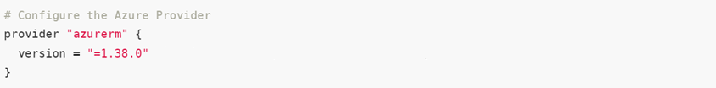
Configuring Azure
Notes:
The Azure Provider can be used to configure infrastructure in Microsoft Azure using the Azure Resource Manager API's.

Slide 12
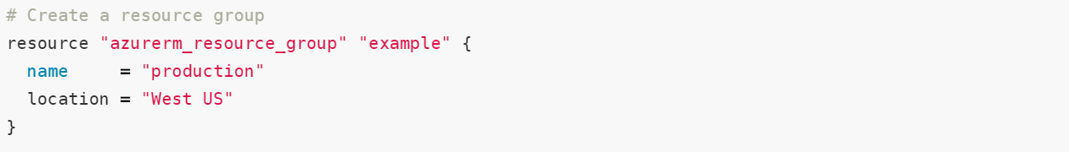
Creating a resource group
Notes:
The Azure Provider can be used to configure infrastructure in Microsoft Azure using the Azure Resource Manager API's.

Slide 13
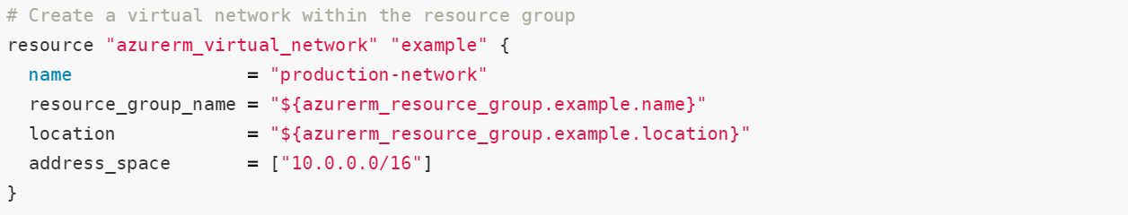
Creating a virtual network
Notes:
The Azure Provider can be used to configure infrastructure in Microsoft Azure using the Azure Resource Manager API's.

Slide 14
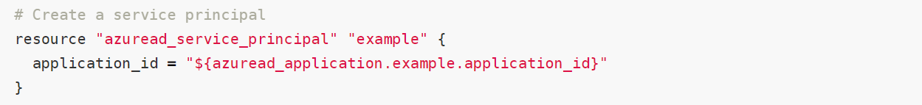
Create a service principal/ AAD
Notes:
The Azure Provider can be used to configure infrastructure in Microsoft Azure using the Azure Resource Manager API's.

Slide 15
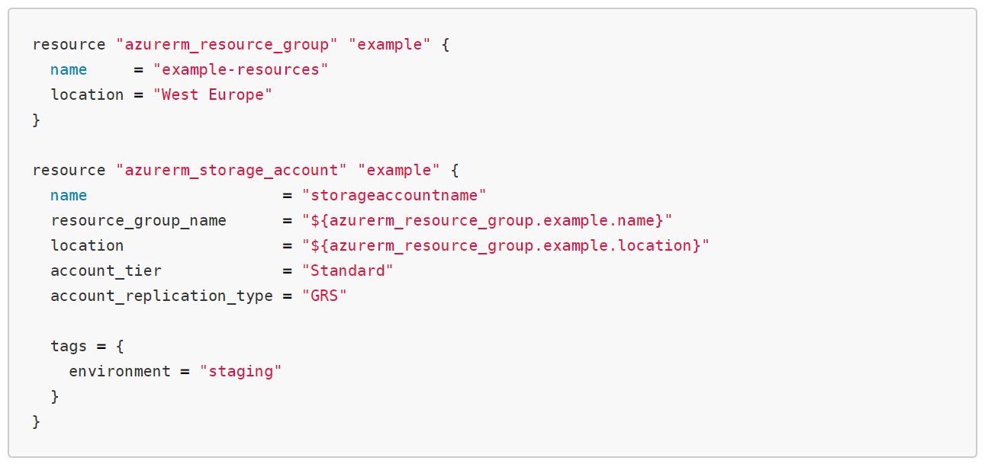
Storage account

Slide 16
Upcoming Changes in Azure 2.0
Existing Resources will be required to be imported
Custom Timeouts will be available on Resources - this will allow you to specify a custom timeout for provisioning the resource in your Terraform Configuration using the timeouts block.
New resources for Virtual Machines and Virtual Machine Scale Sets
Removing Fields, Data Sources and Resources which have been deprecated

Slide 17
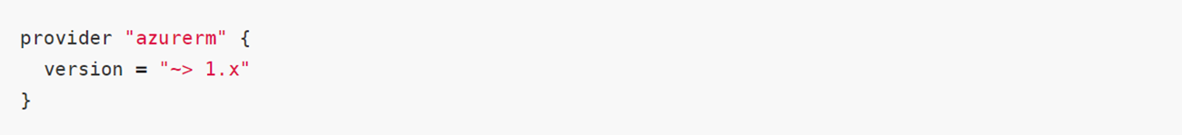
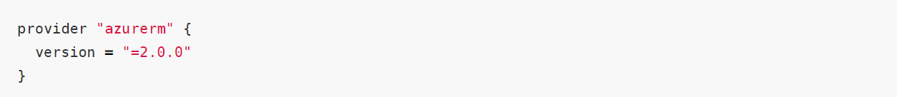
How to handle unsupported Azure features in Terraform
Initialize the configuration directory to any 1.x release
Once version 2.0 of the AzureRM Provider is released - you can upgrade by to the version specified in the Provider block:
Notes:
One big issue with any third-party tool is that new features may not always be available right away.
Terraform had day zero support for both Kubernetes on Azure, Microsoft worked closely with hashicorp to make sure it was possible.
Version 2.0 of the AzureRM Provider is a major release and as such includes some larger-scale changes which are outlined in this document.

Slide 18

Questions?

